Slide 1



IMPACT OF INFLATION ON CONSUMER SPENDING IN NIGERIA
Damilola Olanrewaju
3/10/2024

Slide 2
OUTLINE
Introduction
Overview
Key Questions
Findings & Insights
Summary

Slide 3

INTRODUCTION
This is my entry for the Data Analytics competition organized by Cortouch Media, a leading Tech Training Organization in Ibadan, Nigeria.
3

Slide 4

OVERVIEW

Slide 5
“To Analyze the Impact of Inflation on Consumer Spending in Nigeria”
OBJECTIVE
5

Slide 6
Definition of Terms
Consumer Price Index: The Consumer Price Index (CPI) measures the average change over time in the prices consumers pay for a representative basket of consumer goods and services. The CPI is a measure of and reflects inflation as experienced by consumers in their day-to-day living expenses. It is also known as the headline CPI. CPI = ( Value of Basket in Current Year / Value of Basket in Base year ) x 100
Inflation: Inflation is a gradual loss of purchasing power that is reflected in a broad rise in prices for goods and services over time. It allows for a single-value representation of the increase in the price level of goods and services in an economy over a specified time.
Inflation rate = ( Current CPI – Old CPI / Old CPI ) x 100
*where Old CPI is the CPI for comparison e.g. Base CPI or CPI of a previous year.
Core CPI: This represents the consumer price index minus food and energy. It is a more stable representation of the consumer price index as the prices of food and energy tend to be volatile. It is usually preferred when making monetary policies.
6

Slide 7
Definition of Terms (cont’d)
Monthly Index: This refers to the calculated CPI for a given month.
12-month Average Index: This refers to the average monthly index, calculated over a 12-month period.
Month-on-month inflation rate: This is the percentage change in the consumer price index(month) between the current and previous month.
Year-on-year inflation rate: This is the percentage change in the consumer price index between any month of interest and the same month in the previous year.
12-month Average Inflation rate: This is the percentage change in the 12-month Average Index between any month of interest and the same month in the previous year.
7

Slide 8
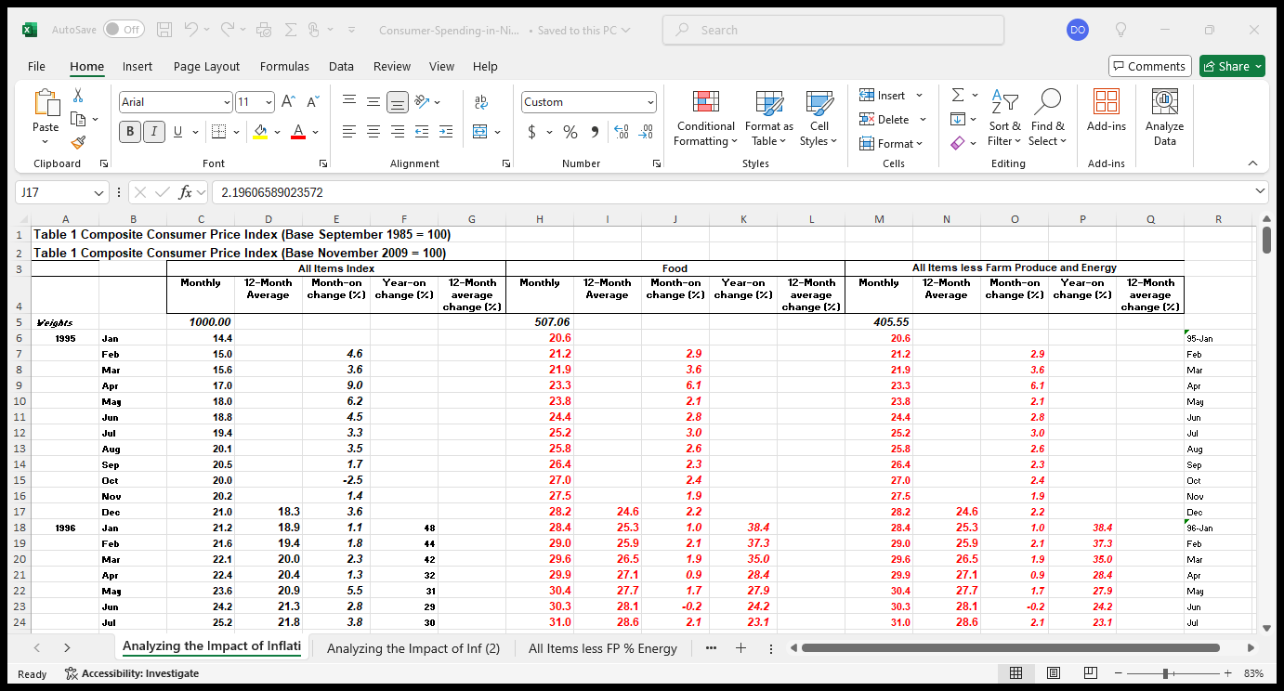
Dataset
The dataset was provided by Cortouch Media.
It contained 17 columns and about 350 rows.
It contained the Consumer Price Index and Inflation rate for 3 categories of goods and services (All items, Food, and Core-CPI - All items less Farm produce and Energy) from January 1995 to January 2024.
8

Slide 9

Key Questions
What is the short-term (monthly) and long-term (Yearly) trend of the consumer price index from 1995 to January 2024, and is there any difference?
How does this trend compare across the three categories?
What is the Inflation rate trend from 1995 to 2024, for both Month-on-month and Year-on-year changes across all categories and are there any notable similarities or differences?
Impact of inflation on consumer spending in Nigeria
9

Slide 10

Findings & Insights

Slide 11
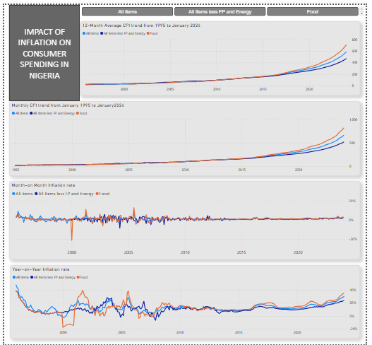
Findings & Insights (1) - Overview
The base year was 2009, precisely in the month of November with a CPI of 100.
A weighted average index of 1000 was used to represent the average total index of all goods and services.
Food contributes 50.7% of all consumer spending, while the core CPI contributes 40.6%.
A line chart best demonstrates the trend of a variable over time.
Inflation will be the focus of the findings as the topic suggests.
11

Slide 12
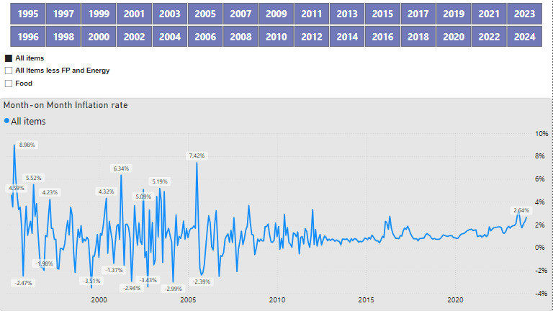
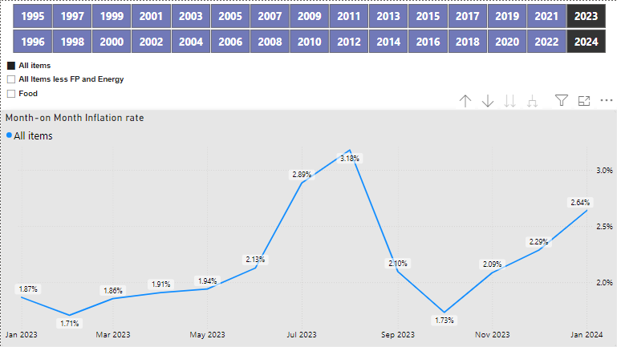
Findings & Insights (2) – “All Item” Month-on-Month Inflation
The inflation rate was the highest between March and April 1995, with a rate of 8.98%, and lowest between July and August 1999 with a rate of -3.51%.
As of January 2024, month-on-month inflation rate was 2.64%, a 0.35 Increase when compared to December 2023 month-on-month inflation of 2.29%.
This implies that the price of goods and services of All Items averagely increased by 2.64% between December 2023 and January 2024.
12

Slide 13
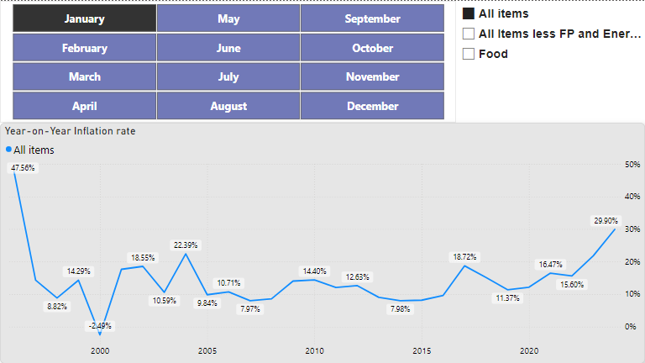
Findings & Insights (3) – “All Item” Year-on-Year Inflation
Using January as the month of Interest, the maximum year-on-year inflation rate is 47.56%, and the minimum is -2.49% in 1995 and 2000 respectively, with an average inflation rate of 14.41% between 1995 and 2024.
Inflation between January 2023 and January 2024 was 29.90%, 8.08 more than January 2023(21.82%).
13

Slide 14
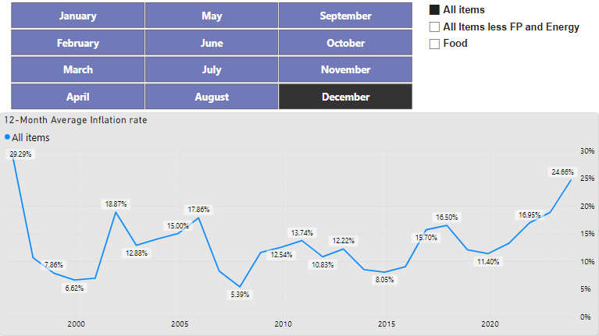
Findings & Insights (4) – “All Item” 12-Month Average Inflation
For the year 2023, the 12-month average inflation rate in December was 24.66%, compared to 18.85% in December 2022. This was however less than the rate for January 2024 which was 25.35%.
14

Slide 15
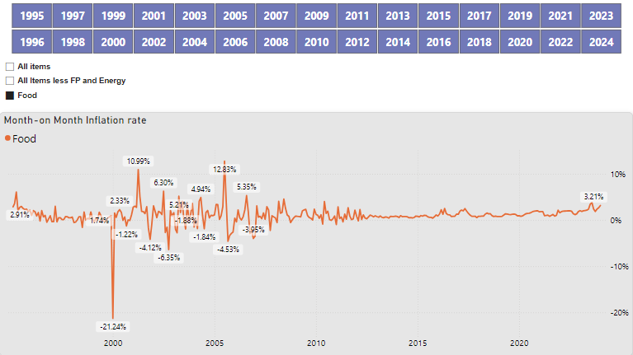
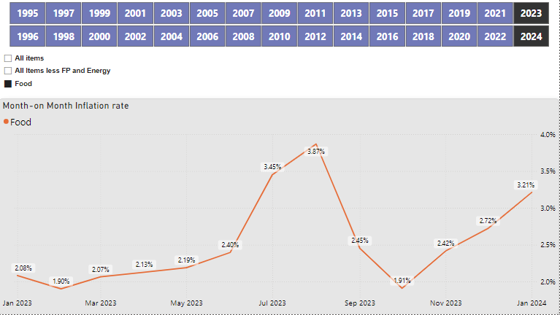
Findings & Insights (5) – “Food” Month-on-Month Inflation
The inflation rate was the highest between June and July 2005, with a rate of 12.83%, and lowest between December 1999 and January 2000 with a rate of -21.24%.
As of January 2024, month-on-month inflation rate was 3.21%, a 0.49 Increase when compared to December 2023 month-on-month inflation of 2.72%.
This implies that the price of Food averagely increased by 3.21% between December 2023 and January 2024.
15

Slide 16
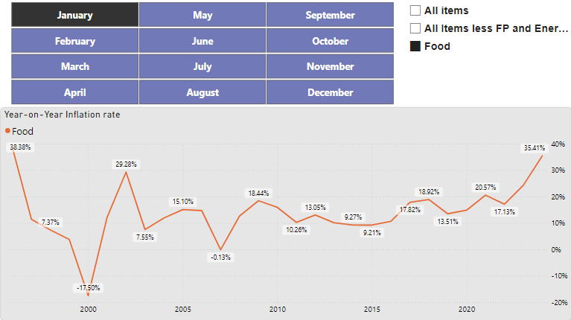
Findings & Insights (6) – “Food” Year-on-Year Inflation
Using January as the month of Interest, the maximum year-on-year inflation rate is 38.38%, and the minimum is -17.50% in 1995 and 2000 respectively, with an average inflation rate of 14.00% between 1995 and 2024.
Inflation between January 2023 and January 2024 was 35.41%, 11.09 more than January 2023(24.32%).
16

Slide 17
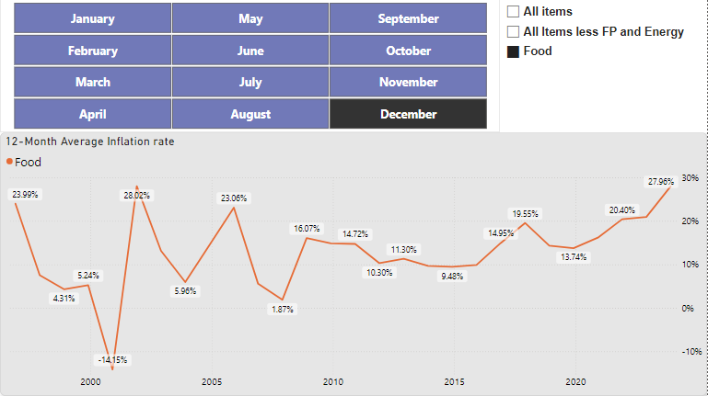
Findings & Insights (7) – “Food” 12-Month Average Inflation
For the year 2023, the 12-month average inflation rate in December was 27.96%, compared to 20.94% in December 2022. This was however less than the rate for January 2024 which was 28.91%.
17

Slide 18
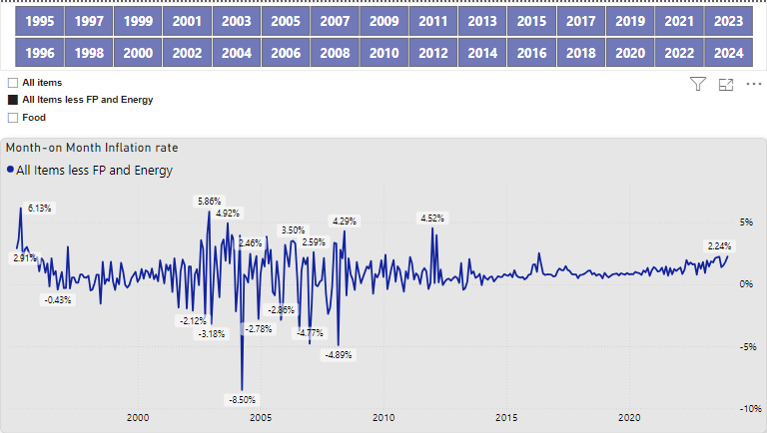
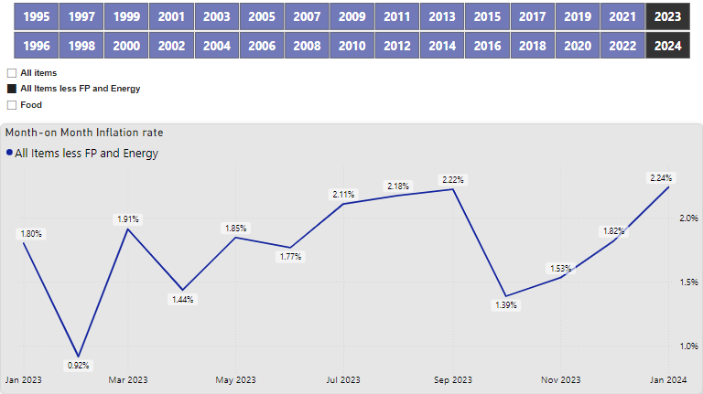
Findings & Insights (8) – “Core CPI” Month-on-Month Inflation
The inflation rate was the highest between March and April 1995, with a rate of 6.13%, and lowest between March and April 2004 with a rate of -8.50%.
As of January 2024, month-on-month inflation rate was 2.24%, a 0.42 Increase when compared to December 2023 month-on-month inflation of 1.82%.
This implies that the price of Food averagely increased by 2.24% between December 2023 and January 2024.
18

Slide 19
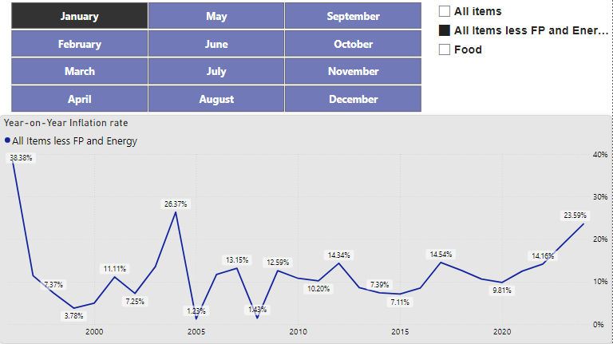
Findings & Insights (9) – “Core CPI” Year-on-Year Inflation
Using January as the month of Interest, the maximum year-on-year inflation rate is 38.38%, and the minimum is 1.23% in 1995 and 2000 respectively, with an average inflation rate of 12.00% between 1995 and 2024.
Inflation between January 2023 and January 2024 was 23.59%, 9.43 more than January 2023(14.16%).
19

Slide 20
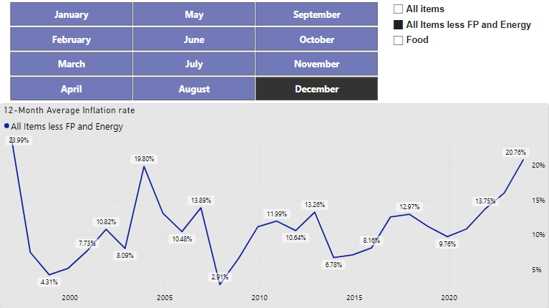
Findings & Insights (10) – “Core CPI” 12-Month Average Inflation
For the year 2023, the 12-month average inflation rate in December was 20.76%, compared to 16.02% in December 2022. This was however less than the rate for January 2024 which was 21.15%.
20

Slide 21

Summary
The findings in this analysis demonstrate a steady rise in inflation over the 29 years with significant variability across the three categories.
The core CPI inflation rates give a more stable representation of the inflation trend.
The year-on-year and 12-month average inflation rates are less volatile and unstable than the month-on-month inflation rates which can be affected by price shocks and seasonal changes.
21

Slide 22
Conclusion
One of the major impacts of rising inflation is the fact that prices of goods and services also increase, and except there is an increase in the income of the people, their purchasing power is being eroded. As a result, they can only afford to buy less making it more expensive to maintain the same standard of living.
You can interact with the PowerBi report here.
Impact of inflation on consumer spending in Nigeria
22

Slide 23




Thank you
Damilola Olanrewaju
dolanrewaju231194@gmail.com
www.linkedin.com/in/damilola-olanrewaju-0478371a3

